Slide 1
CAPSTONE PROJECT
Students’ Early Attrition Modelling for Clearwater State University

Slide 2
Goals of Project
• Increase enrolment of students
• Improve retention, progression and graduation rates
• Recruit better academically qualified undergraduate and graduate students
• Increase external funding and recognition

Slide 3
Exploratory Data Analysis
Batch year vs cost of program
Attrition across background
If we take a look at last three years, we can see average Cost of attend is increasing, consequently attrition is also increasing.
Less student left the college in the year 2007 among all batches despite cost of program was high.
Student background seems to be an important factor and can help deciding whether student is predisposed to attrite.

Slide 4
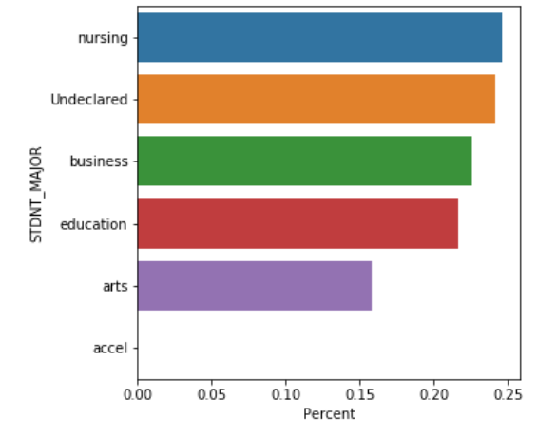
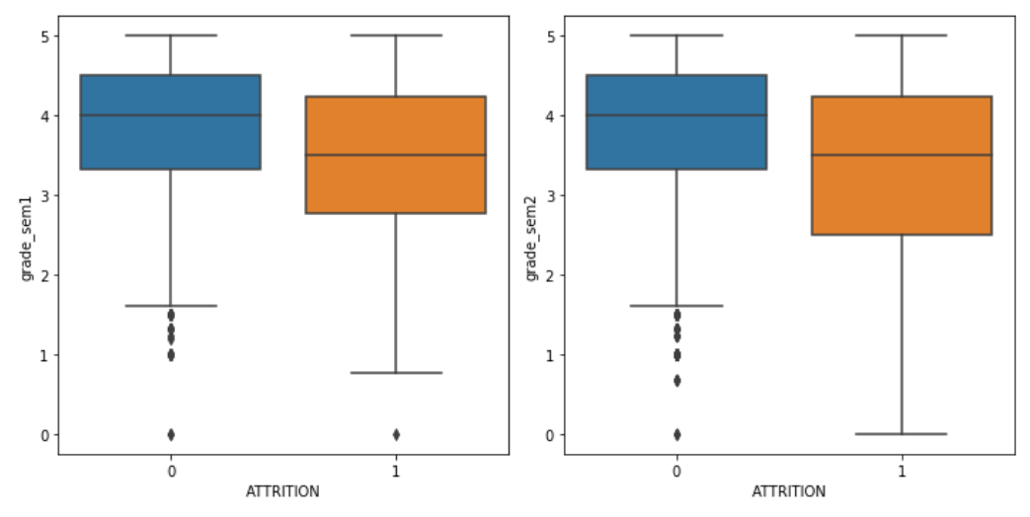
Exploratory Data Analysis
Grades
Major
First sem
Second sem
Attrition rate is higher in Nursing stream and lowest in arts stream.
No student left in last few years who has joint enrolment or early admission
Lower grades leading students to attrite.
Students obtaining lower grades in second semester are more likely to leave than obtaining lower grades in first semester.
Who are returned to 2nd year don’t have much difference in their performance between first & second semester.

Slide 5
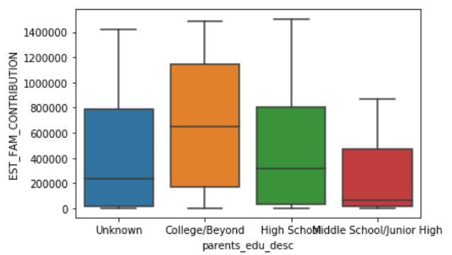
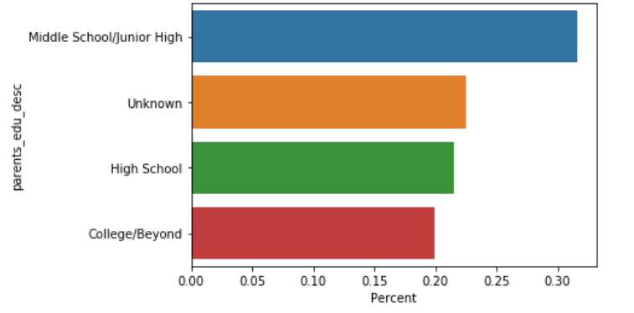
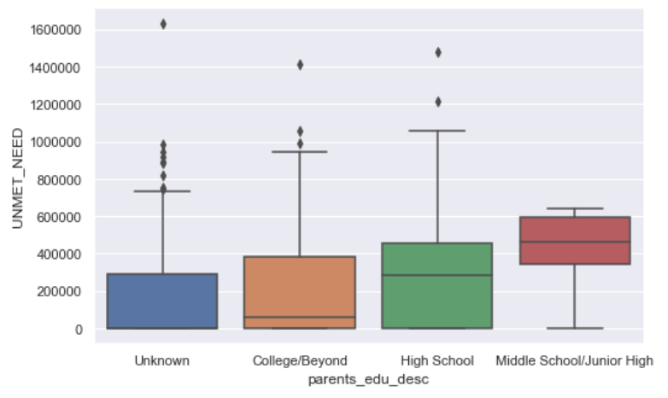
Exploratory Data Analysis
Family Contribution
Parents Education
2
1
Unmet need
3
Plot 1,2 & 3 are interrelated to each other.
(1) Higher the attrition lower the family education
(2) Lower the parents education lower the family contribution.
(3) Lower the family contribution higher the unmet need.

Slide 6
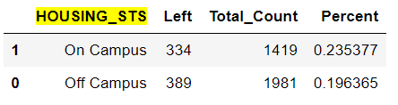
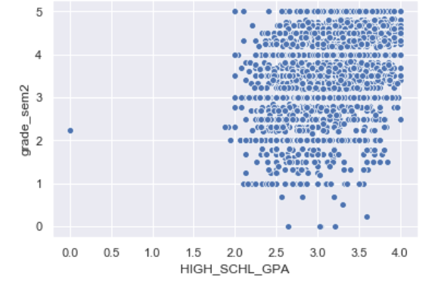
Segment Analysis – Student Application Data
Housing Status
Attrition percent is higher in students who live in the university campus than who live outside of the university campus.
High school GPA
There is a relation between high school GPA & student grades.
Most of the Students with higher GPA tend to obtain more grades in university.
In the plot, Data is more denser in upper right corner which indicates higher the GPA higher the grades.
Parents Education
As demonstrated in previous slide; parents education is a crucial factor.

Slide 7
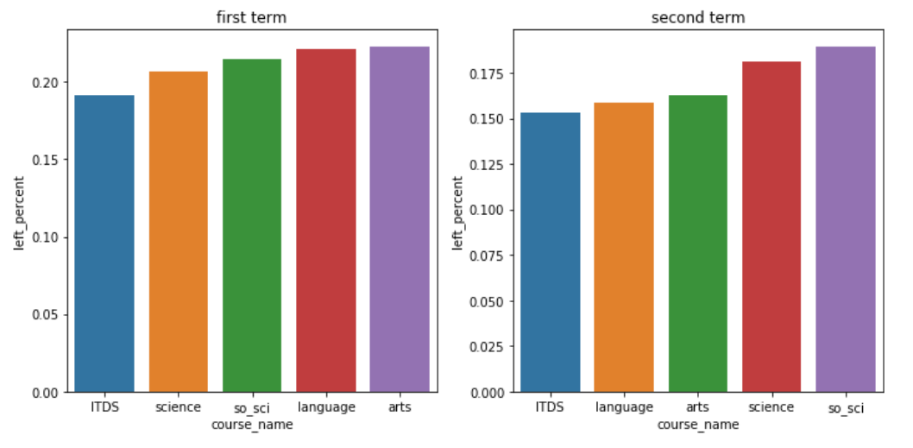
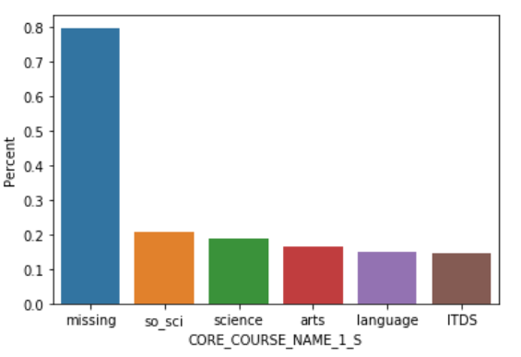
Segment Analysis – Course Preferences
If we compare courses chosen between 1st & 2nd semester and disregarding missing values, we may find that which courses chosen in 1st & 2nd semester do matter.
Science & social science are chosen in first sem have lower attrition rate than both chosen in 2nd sem.
Whereas, Language & arts chosen in 1st sem have higher attrition rate than chosen in 2nd sem.
This plot is rendered based on course name 1 in 2nd sem considering missing values.
If student has not taken any course in second sem ie. showing ‘missing’, then we can implicate he/she has left the college.

Slide 8
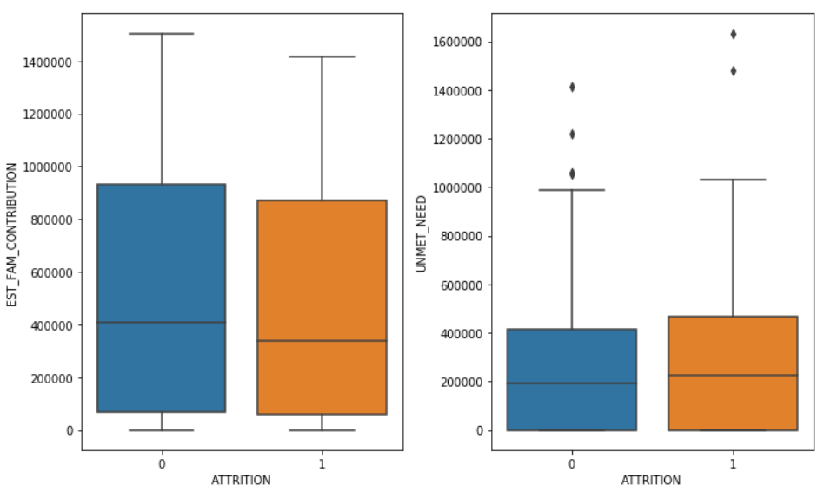
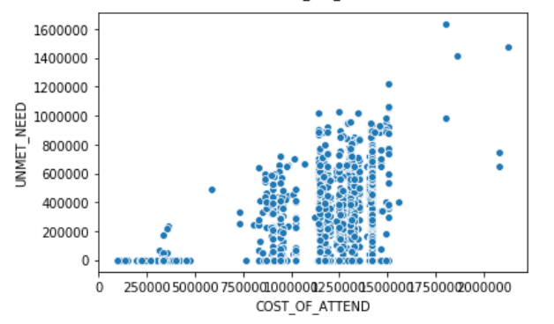
Segment Analysis – Financial Indicators
Gross financial need variable is dependent on estimated family contribution. So, we are disregarding that variable.
As boxplots show, student who left before 2nd year could not afford fees(ie. higher unmet need) due to less family contribution.
Increase in cost of attend results increase in unmet need.
And, increase in unmet need results increase in risk of student attrition.
From scatter plot, we can interpret that unmet need remains zero till the certain cost of attend as many would have afforded the certain fees.

Slide 9
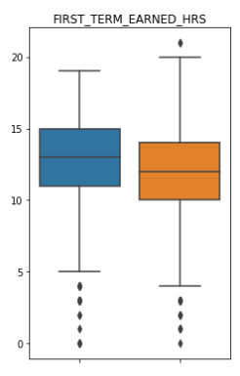
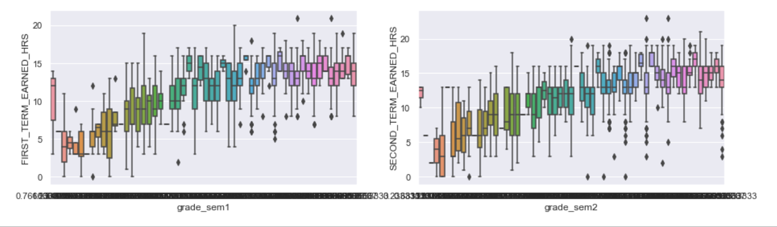
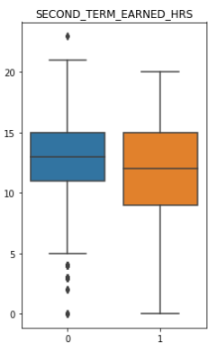
Segment Analysis – Performance Record
Second term earned hours have more contribution in deciding risk of attrition than first term earned hours.
Also, earned hours are much dependent on respective semester grades. ie. higher the grades higher the earned hours and vice versa.

Slide 10
Statistical Model - Data preprocessing
Data has been prepared for model building as follows –
Dropped variables which were not looking significant or those were having strong correlation.
Course names & major names have been substituted with their main stream name.
Imputed missing values wherever necessary. However, new category ‘missing’ has been created for missing course names presumably considering missing cells may not actually be missing and in fact students have not shown up for next semester.
Average has been taken for all course grades for both semesters and derived new variables for ease of analysis. Also, for mother & father education – new variable parents education is derived.
Converted some qualitative variables to quantitative & vice versa.
Target variable ‘RETURNED TO 2nd YEAR’ has been changed to ‘ATTRITION’.
Data has been randomly spilt in train & test data. 80% is used to train machine learning model & 20% is used to test the model.

Slide 11
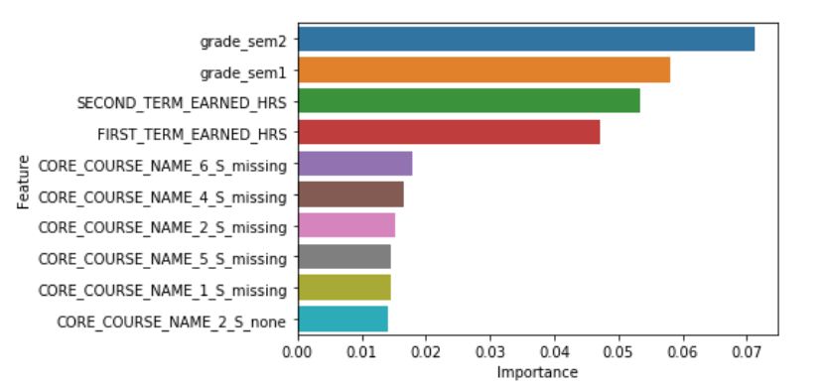
Statistical Model - Results
Model Results :
Random forest model is finalized on the basis of highest accuracy of model predictions after running several models - Logistic Regression, Extreme Gradient Boosting, GBM
Model accuracy is 0.81 % which means 553 records is accurately predicted out of 680 records of test data .
These are top 10 features according to the model which has most of the part in predicting target variable –

Slide 12
Business Interpretations
Based on the model, it has been clear that student grades have utmost importance than any other factors involved in the model.
Total 3400 records were used for model - 2380 are used to train the model and 1020 are used to test the model accuracy. Model has been able to predict 81% of the records accurately.
As seen in exploratory data analysis, students tend to obtain higher grades if they had obtained good school GPA. But, this is not applicable for all of them. Which means Performance record segment has upmost importance than any other segment.
Students who are missing in second semester; who may not have chosen any course in 2nd semester tend to leave more likely. This is happening with students who have lower performance in 1st semester.
Parents education also seems to be an important factor. Parents with higher education have higher propensity to contribute more for students financial need. Moreover, cost of attend has increased year on year from 2005 to 2009.

Slide 13
Recommendations
Pay more attention to students particularly who obtain less grades in 1st semester. Intimate them and ask if any help is required. Reach out to ones who don’t show up in 2nd semester and ask why they are not attending. Assess student performance more frequently by conducting tests.
Nursing stream has higher attrition among all others. Maybe, some students are not choosing right stream which is appropriate for them. For this, counselling sessions can be conducted before admissions in order to help students choose right stream.
Check financial background if family is able to pay or not. Provide financial aid, scholarship, loan, etc if required. Defer the cost if student is not able to pay in given time. Reach out for external funding for those are having consistent performance in school or graduation college, which may also perform well in the university.

